Slide 1
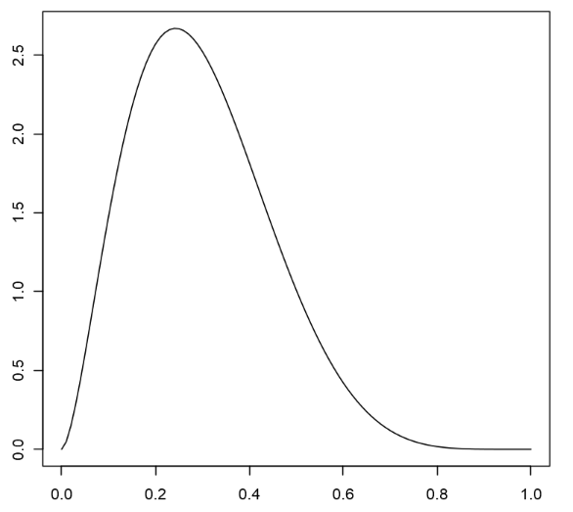
U
C
y
V

Slide 2

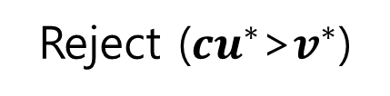


Reject (${cu}^{∗}$>$v^{∗}$)
U
C
$${cu}^{∗}$$
$$v^{∗}$$
$$v^{∗}$$
V

Slide 3
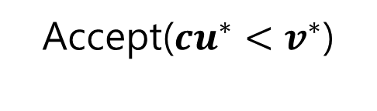

Accept(${cu}^{∗}<v^{∗}$)
U
C
$$v^{∗}$$
$${cu}^{∗}$$
$$v^{∗}$$
V

Slide 4

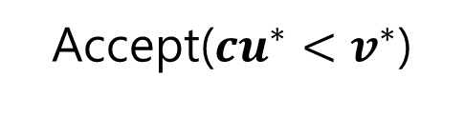

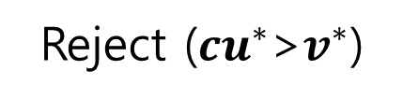
Reject (${cu}^{∗}$>$v^{∗}$)
Accept(${cu}^{∗}<v^{∗}$)
U
U
C
C
$$v^{∗}$$
$${cu}^{∗}$$
$${cu}^{∗}$$
$$v^{∗}$$
$$v^{∗}$$
V
$$v^{∗}$$
V

Slide 5
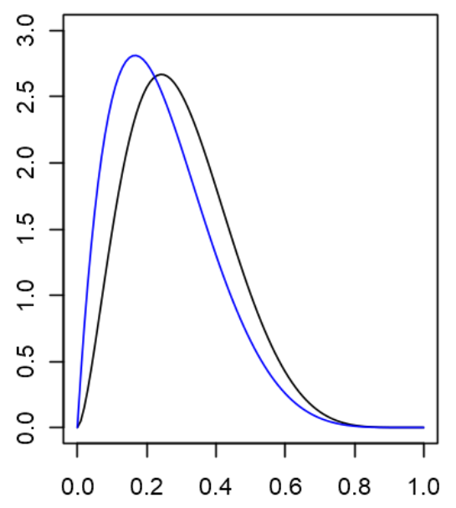
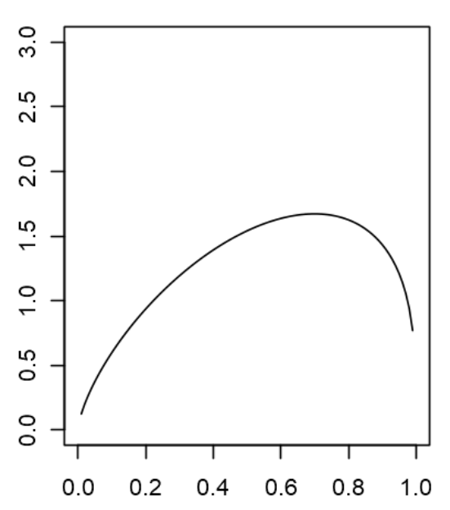







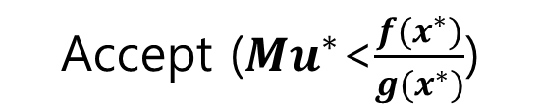


Accept (${Mu}^{∗}$<$\frac{{f(x}^{∗})}{{g(x}^{∗})}$)
$$g$$
$$f$$
$${g(x}^{∗})$$
M
$$\frac{f(x^{∗})}{g(x^{∗})}$$
$${Mu}^{∗}$$
$$\frac{f(x)}{g(x)}$$
$${f(x}^{∗})$$
$$x^{∗}$$
$$x^{∗}$$

